Slide 1


Mantid Scientific Steering Committee
Nick Draper
12/01/2011

Slide 2




Major Tasks presented last meeting
Major Items
  General
    Easy user control for plotting distribution data
    Multi file loading and summing
    Python interface improvements
  Technical
    Build System improvements
    Python code and quality review
    SNS Build Server (RHEL5, Windows 7 64Bit)

Slide 3

Major Tasks presented last meeting
  SNS
    File Archive search support
    SNS catalog search (pending catalog choice)
    Event Workspace with weights
    Further filtering & splitting event data
    Powder diffraction user interface
    Direct inelastic user interface integration
    EQ-SANS requirements
  HFIR
    SANS GUI improvements
    Initial Triple Axis support

Slide 4

Major Tasks presented last meeting
  ISIS
    Continued work on Monte Carlo absorption correction
    SANS 1D & 2D data investigation and improvements
    Further Indirect Interface improvements
    Further Muon interface improvements
    Vesuvio support
  Visualisation and Analysis
    Limited Prototype
      Multidimensional workspaces
      4 Dimensional parallel visualization of large datasets
      Initial cutting and slicing operations
      Simple background quantification

Slide 5
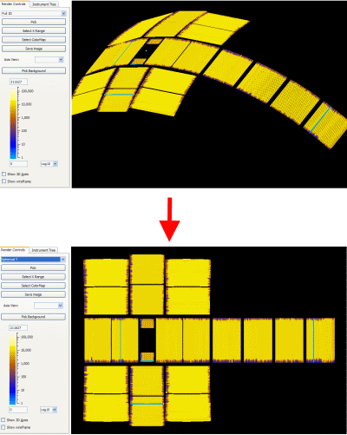
Progress over the last iteration
Instrument Display
  Unwrap instrument on Cylinder or sphere
  Unwrapped pick mode options
    Extract to new WS
    Group to new WS
    Create a grouping file including/excluding selection
  Clipping issues resolved
  Wireframe display option

Slide 6
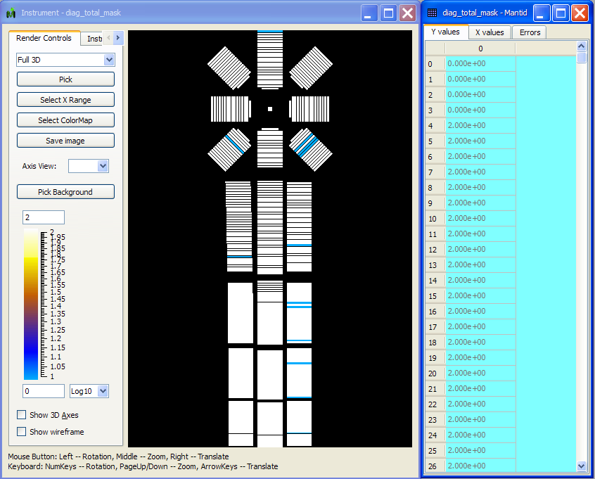
Progress over the last iteration
Framework
  Mask Workspaces
    Holds masking without data
    Visualised by the Instrument view
    ExtractMasking to extract from any workspace
    Applied to any other using MaskDetectors.
    Plus algorithm can create a union of the MaskWorkspaces.

Slide 7
Progress over the last iteration
Framework
  Initial Monte Carlo Absorption correction
    single scattering
    complex sample environment
    Currently the environment has to be built up in C++
  Load algorithm
    Automatically identifies file type & loading routine
    Limited use in UI, but will be extended

Slide 8
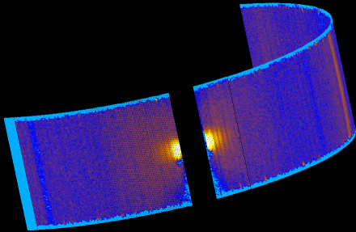
Progress over the last iteration
Event data
  Event weights and errors
    Only stored if needed
  Allows events to be maintained through more complex operations
  Several algorithms have been enhanced to take advantage of this:
    Binary Operations: Minus, Multiply and Divide
    Correction Operations: NormaliseByCurrent

Slide 9
Progress over the last iteration
SANS
  File extensions are now automatically added to save files
  2D Q reduction has been improved to correctly respect masking and the errors returned have been improved
Powder Diffraction
  A simple powder diffraction for the SNS interface has been added as an algorithm: SNSPowderReduction.

Slide 10
Progress over the last iteration
Direct Inelastic
  Now supports SNS instruments
    Conversion
    Diagnosis routines
  Diagnose* algorithms now output MaskWorkspaces
  The masking from the WB and data is unioned before applying to both.
  Optimised to prevent loading the data twice

Slide 11
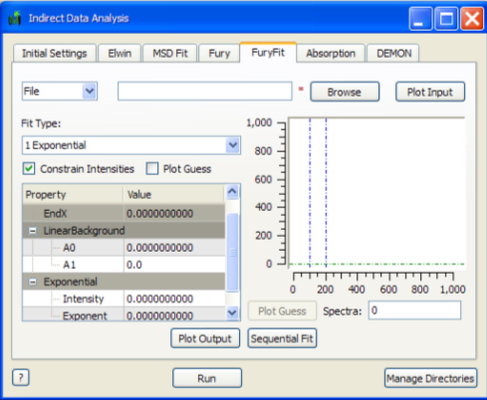
Progress over the last iteration
Indirect Inelastic
  IndirectAnalysis interface
    The simple "DEMON" powder diffraction analysis has been separated into it's own interface
    A new Convolution Fit tab has been added

Slide 12
Progress over the last iteration
Instrument Definitions
  Support multiple IDFs for single instrument
    Allows for changes in the instrument over time
    Valid from and to dates are included in the IDF
    Compared to the run start date to decide which IDF to use
  Support for radians as well as degrees
  A definition for Basis is now included.
Crashes/Bugs
  7 Notable bugs corrected

Slide 13
Next Release
Target Date
  25th February 2011
Major Items
  Selected by you
    Blocker – Instrument would not be able to start / process data
    Critical – Impact on some users experiments
    Major – Planned migration to Mantid would be affected, but other software could cope
    Minor – I really want this, but none of the above apply

Slide 14
Direct Inelastic - ISIS
Blocker
    Implementation of the Bleed Correction in the diag suite ( i spoke to Martyn about this and he is going to look at it)
    Overall speed improvements for the reduction (currently it takes 1min12s to run my benchmark merlin data set which is 20s slower than previous iterations)
Critical
  A unified ISIS/SNS reduction stream and a unified GUI
    the current GUI is OK for startup as it will probably only really be used on MARI
  Reduction capable of dealing with ISIS event mode data formats.
    essential for LET

Slide 15
Direct Inelastic - ISIS
For instrument view:
Blocker
  We need to be able to look at the sum of the counts in the individual tubes to replicate the functionality of the matlab detector test program
Major
  All the other IV things we discussed.
  Flat view unwrap point is wrong for some instruments

Slide 16
Muons - ISIS
Major
  PlotAsymmetrybyLogValue
    Allow results to be appended to previous analysis
  Musr data analysis panel
    Complete enough for basic time domain analysis in time for the startup.

Slide 17
Indirect Inelastic - ISIS
Major
  Support for ISIS & OSIRIS
    Complete the validation against MODES
  Support for TOSCA
    Validation of reduction against previous solution

Slide 18
Diffraction – ISIS
Blocker
  WISH
    Provision of a suitable 3+ dimensional workspace that supports external visualization
Critical
  PEARL
    Support for loading and applying pre-calculated absorption corrections
Minor
  POLARIS
    Support for total scattering absorption corrections

Slide 19
SANS - ISIS
Critical
  Support for Wavelength loops
  Improved Add tab support for multiperiod files
Major
  Diagnostic routines (display H, V, & time)
  SANS specific plotting & fitting
Minor
  Improved integration between UI and python scripting
  Batch mode support for multi period files

